Slide 1

OH Work Plan Jobs
Jody Picou & Brant Hood

Slide 2
Work Plan Jobs
There’s nothing easy about an overhead work plan. But, we’ll show you all the tricks that make for a successful design and accurate pulling of materials with appropriate amounts of installs and retirements.
In todays scenario we are going to take the existing V-Phase and convert it 3 Phase. The existing conductor is 4 ACSR with a 4ACSR Neutral.
We will leave the 4 ACSR neutral and retire the 2 spans of 4 ACSR primary. We will upgrade the 4 ACSR primary to 1/0 ACSR.
The techniques today will show you how to retire only the primary 4 ACSR and leave the neutral while adding in 3 spans of 1/0 primary.
We will also cover how to call for the correct pole top assemblies while only sending the correct material to accounting.

Slide 3
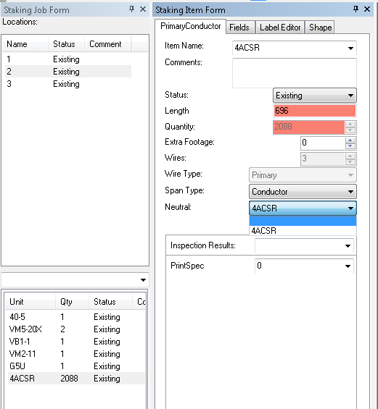
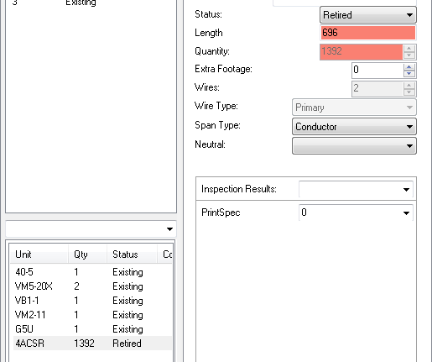
Work Plan Jobs
We are going to create locations at each of our
existing poles.
Once you have the locations you will open the
staking Item Form on the existing conductor and
change the neutral to “Blank”.
After the neutral is blank you can set that existing
conductor to retired. (This will retire 2 runs of
4 ACSR primary)

Slide 4
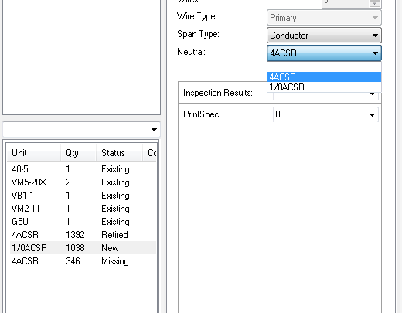
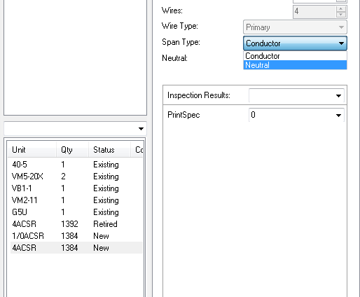
Work Plan Jobs
We will now call for our new 1/0 ACSR and our 4 ACSR neutral.
On the 4 ACSR we will define this wire as Neutral
and make the status Missing. (By classifying the
4 ACSR as neutral, it will not post the 4 ACSR line
symbol on the map.)
On our 1/0 ACSR conductor we will specify that the
neutral is 4 ACSR. This will only give us 3 runs of
1/0 ACSR, which
is correct for
accounting.

Slide 5
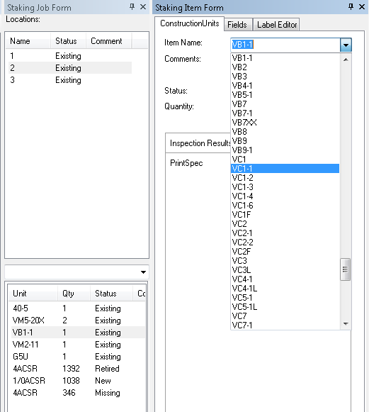
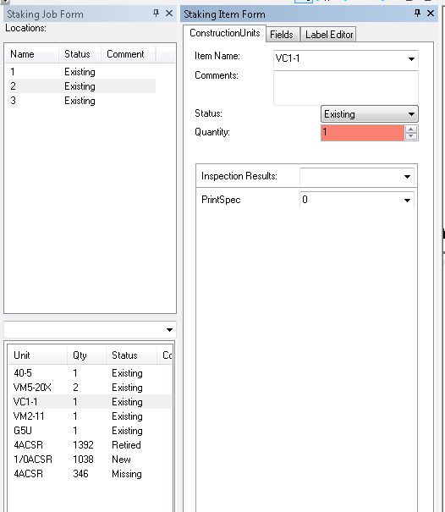
Work Plan Jobs
For our Pole Top units we will select the existing VB1-1 and change the construction unit name in the Staking Item Form. (This will change the unit name when the job is posted to GIS but will not send any materials to accounting)

Slide 6
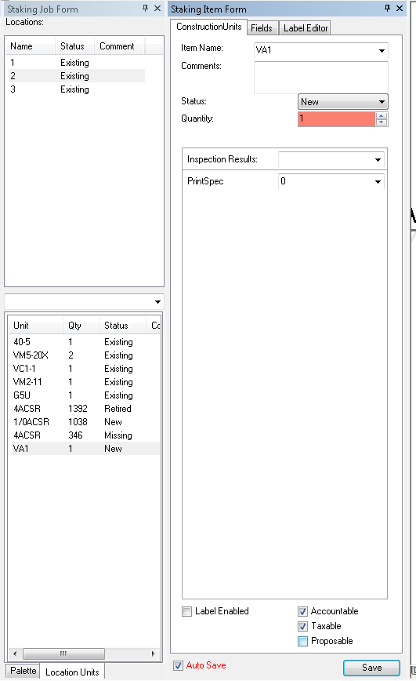
Work Plan Jobs
In order to send the correct material to accounting we will call for our VA1 and uncheck Proposable. (By unchecking Proposable it will prevent theVA1 from being posted to the map. By leaving the Accountable and Taxable checked, it will send the correct material to accounting and warehouse.
By completing this process we will be posting a VC1-1 to GIS
but only sending the VA1 material to accounting.

Slide 7
Work Plan Jobs
If we are shortening spans we will use the (Right Click) “Add New Location” option (or the HotKey of “A”). We will continue to follow the same process as stated in previous slides.
Add our 1/0 ACSR as new conductor and our 4 ACSR as neutral.
Follow the same procedure by specifying the 4 ACSR as Neutral and selecting the 4 ACSR as neutral in the Staking Item Form for the 1/0.
Any neutral that is associated with conductor is strictly an attribute for that conductor. Any neutral line feature will not post to the map.

